Slide 1

Git (for Dummies)
By: Shereece A. A. Victor
For UWICS Project Month 2020

Slide 2
Here’s what we’ll be covering
Why Git?
GitHub
The Basics
Git Clients
Git Kraken
Some other stuff…

Slide 3
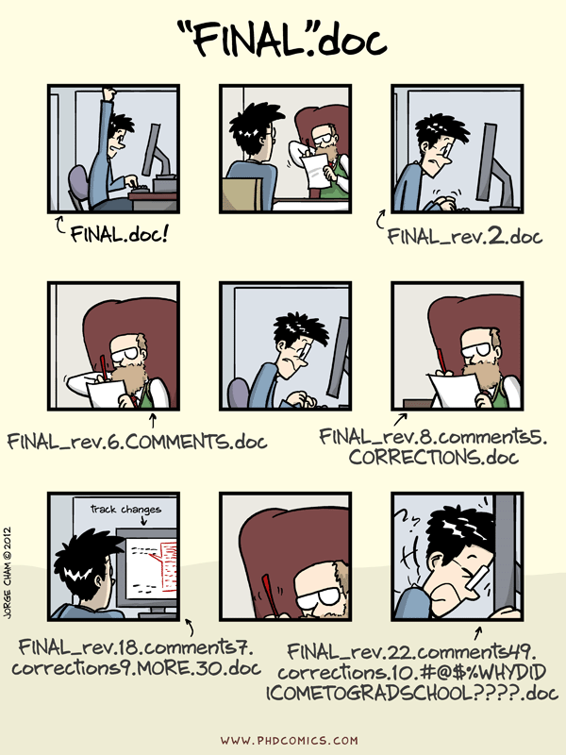
Why Git?
Version Control: A fancy way to say keeping track of changes.
Notes:
Version control is a system that records changes to a file or set of files over time so that you can recall specific versions later.

Slide 4

Then there’s GitHub
Contains a ton of Git repositories.
The largest host of source code in the world.
Code resources and collaboration – Issues, forks, pull requests, open source licenses
Personal repositories - A fancy portfolio that shows you’re more ‘tech-savvy’ than the average secretary

Slide 5

Basics – Creating a Repo
Can be done using the command line
On the GitHub website
Through a client
…Many other ways

Slide 6

Basics – Commits, Push, Pull
Commit : Saving changes to a local repository. Local here meaning, on your computer, not in Trinidad.
Push: Upload changes to the remote repository
Pull: Download changes from the remote repository to the local repository

Slide 7
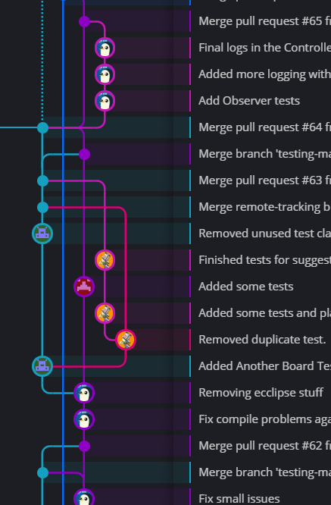
Basics – Branches
Creating Branches allow you to make changes separately.
Allows different versions of the code or files for testing, alternative development or to simply save the master from fatal errors.
You can “Checkout” different branches.

Slide 8

Not so Basic – Pull requests and Merging, Forking
These may cause problems if you don’t know what you’re doing.
Pull Requests are supposed to prevent you from adding unwanted changes to a branch.
Forking someone’s repo, (if it’s correctly licensed) let’s you build on their work or make it your own (with credit given of course).

Slide 9


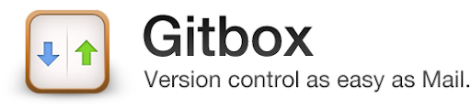
There are many Git Clients
Git for Windows or Linux
QGit (Linux)
Sourcetree (Windows)
GitBox (for Mac)
GitKraken
Integration with IDEs like Visual Studio Code, JetBrains IDEs

Slide 10
I’m biased, so here’s GitKraken:
Undo/redo
Stash/Pop
Ignore
Merge Conflict resolution
Notes:
In addition to being able to commit push and pull, and create gitignore with one click on Git Kraken. There are also

Slide 11
A few things to note
Git doesn’t want your photos, videos, audio files, presentations.
You need to practice.
Some clients leave a lot of room for error, some don’t.
EVERYONE can see your repo.
You can create teams through GitHub Organizations
Notes:
-Those are binary files. They take up a lot of space and even more with each change so you’ll need to get some additional support from Git for those. (Git LFS)
This stuff ain’t simple. It seems so, until you’re working on a group coding project and constantly pushing to the wrong branch or reverting peoples changes or uploading meta data they don’t want to see. You need to get used to it. You should get good.
Clients like GitKraken (I’m very fond) let you make a lot of mistakes, if you take your time and don’t go around madly reverting and deleting.
Not everyone who bounces up your code online is nice. Be mindful of what information is included in what you upload or what they can do with the code you provided.

Slide 12
Resources
Formatting README.md files: https://guides.github.com/features/mastering-markdown/
Codecademy Git Course : https://www.codecademy.com/learn/learn-git (To learn git commands)
Sign up for Project Month here: https://forms.gle/GVktDYY9yMd2MNrS8
Let me know what else to add here..

Slide 13

That’s all folks
Any questions, concerns, corrections, comments, violent outbursts?

